Slide 1
Introduction to Systems Programming and Operating Systems
Project 3
Dawei Li
Feb. 25, 2015

Slide 2
Project Description
You are required to implement a solution to the producer-consumer problem (multiple producers and multiple consumers).
This will help you to understand the synchronization issues of concurrent threads.

Slide 3
Outline of the Problem
1. The problem consists of many (minimum of 4) producer threads and many (minimum of 3) consumer threads sharing a (memory) buffer with multiple (minimum of 20) slots (storage cells).
You can determine the numbers by yourselves, such as 10, 10, 50. you should also vary these numbers to test your program.
Each producer deposits one element into one slot of the buffer each time it “produces”, and each consumer extracts one element from the buffer each time it “consumes”.
The buffer is treated as a circular queue, which means that inserting elements into one end of the queue, and extracting from the queue from the other end.

Slide 4
Consumer extracts
Producer deposits

Slide 5
Outline of the Problem
2. You should use mutex (binary semaphore) objects to implement mutual exclusion between producers and between consumers.
You need to ensure that two tasks cannot access the same buffer slots at the same time. More specifically,
Two producers cannot deposit to the same element at the same time.
Two consumers cannot consume the same element at the same time.

Slide 6
Outline of the Problem
3. In addition, a producer task may not write to the buffer if it is full, and a consumer task may not read from the buffer if it is empty.
These activities will require that the producer or consumer block, until the operation they require can be completed.
This means that a producer blocked on a full buffer can be released from its block because a subsequent consumption has emptied a slot; or a consumer that is blocked on an empty buffer can be released from its block because a producer subsequently deposited a value in the buffer.
In order to implement these “block and release” capabilities, you should use general semaphores for synchronization

Slide 7
Outline of the Problem
4. Your program should save critical event information to a log file.
You should design your program to log the event occurrences that can demonstrate that the program (producer and consumer threads) are executing correctly, that no task has interfered with the other task as it is manipulating the buffer, and that the buffer is not corrupted by the work of the threads.
Part of your design is to consider possible error conditions and to dynamically test to ensure that you have avoided these conditions.
fflush()

Slide 8
Outline of the Problem
5. You will need to vary the speeds of the producer (consumer) depositing (fetching) elements, and demonstrate proper buffer storage and access as the intervals increase and decrease.
[timers or timing loops can be used to implement speed control.]

Slide 9
Outline of the Problem
(6). We suggest that you begin your development by solving the one consumer, one producer problem with a shared multiple storage cell buffer and then build the full solution.

Slide 10
Outline of the Problem
7. You will be implementing this solution in two different operating systems – Linux and Windows 7.

Slide 11
Problem Description Reference:
http://cs.gmu.edu/cne/modules/ipc/aqua/producer.html

Slide 12
Developing in linux using pthread library:
pthread_create
pthread_join
pthread_mutex_lock
pthread_mutex_unlock
pthread_cond_wait
pthread_cond_signal
http://www.dailyfreecode.com/code/producer-consumer-problem-thread-1105.aspx
-lpthread

Slide 13
Developing in Windows (MS visual Studio) using Win32 API.
CreateSemaphore()
ReleaseSemaphore()
CreateThread()
WaitForSingleObject()
http://www.installsetupconfig.com/win32programming/threadprocesssynchronizationapis11_29.html

Slide 14
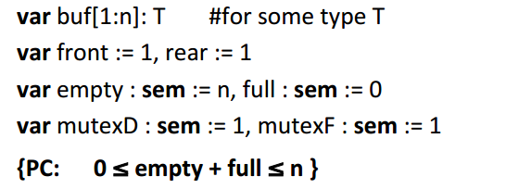
Standard solution to the problem

Slide 15
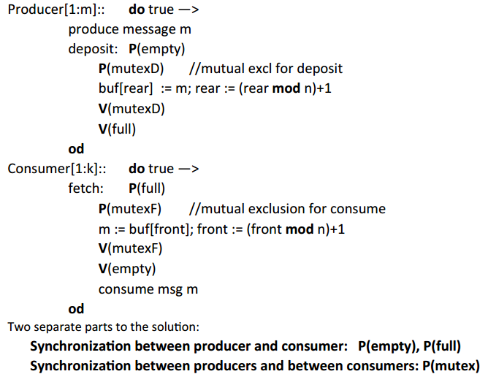
Standard solution to the problem

